Slide 1


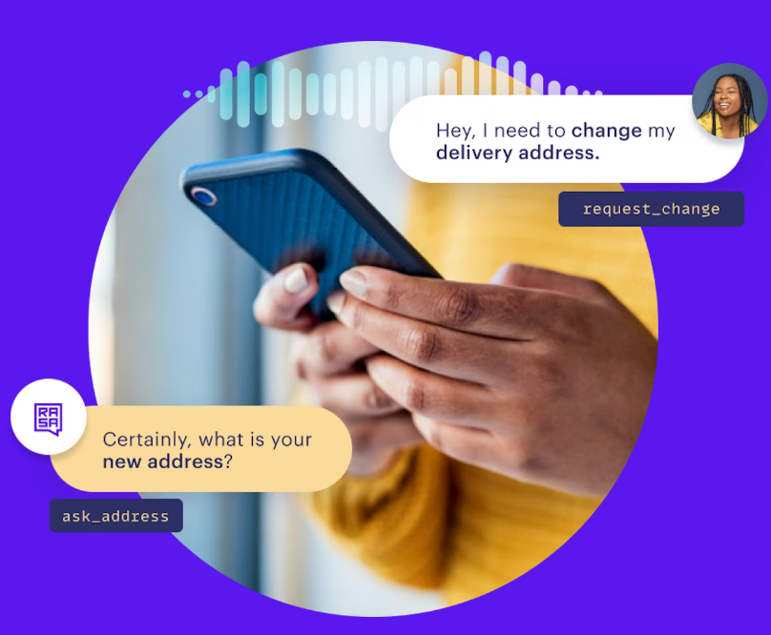

Chatbot Development using Rasa and Python from the scratch -2023
Shambulingaiah B M

Slide 2
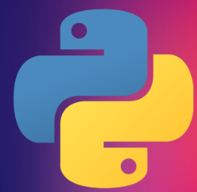



Course Curriculum Overview
Why Rasa? What are its components?
What is NLU(Natural Language Understanding) and why it is required?
Creating Chat bot using CLI(Command line interface).
Connecting to other API’s through Rasa.
How to use Open-AI GPT-3 model inside Rasa chatbot.
Creating API using Flask and hosting it in your local machine.
Connecting Flask API to Rasa webchat.

Slide 3
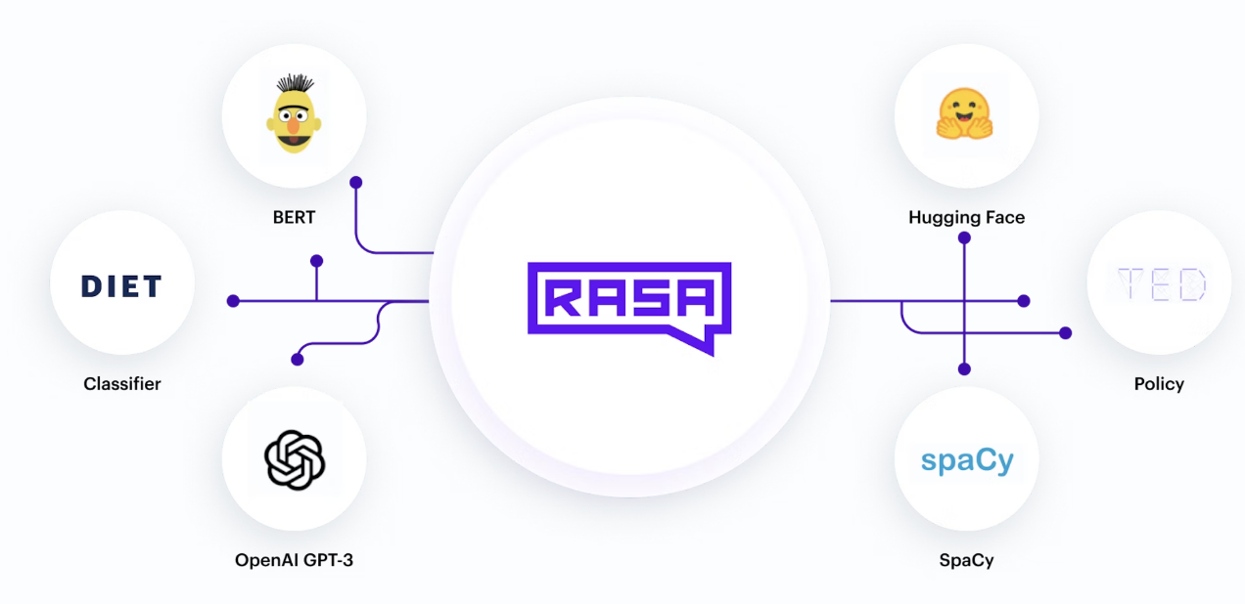
Why Rasa?
Rasa provides flexible conversational AI software for building text and voice-based assistants. Used by developers, conversational teams, and enterprises worldwide.
Future-proof your Conversational AI Product.
Plug and play any NLP or machine learning model into Rasa
*Reference: https://rasa.com/docs/rasa/

Slide 4
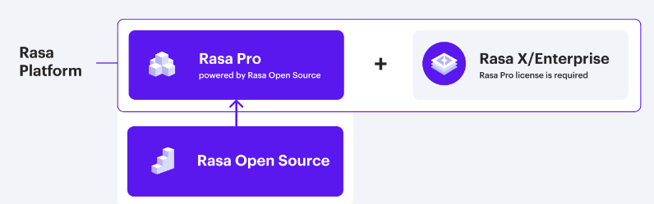
Rasa Platform
Rasa Open Source: is an open source conversational AI platform that allows you to understand and hold conversations, and connect to messaging channels and third party systems through a set of APIs. It supplies the building blocks for creating virtual (digital) assistants or chatbots.
Rasa Pro: State-of-the-art conversational AI framework built with Rasa Open Source. Rasa Pro is the commercial conversational AI infrastructure that is extensible, flexible and enterprise-grade. It has been built and tested to effectively respond to enterprise needs for security, observability and scalability.
Rasa X:Combine with Rasa Pro to enable conversational AI teams with the collaborative, low-code UI they need to build AI Assistants. With Rasa X/Enterprise, you can assess performance, make key improvements, and update content with ease
*Reference: https://rasa.com/docs/rasa/

Slide 5
Rasa Components
Rasa has 5 main key steps to build your assistant. Here are they
NLU Data : It captures user input
Responses : It will assign dialogue response to user input
Stories: It will capture how user interact with chatbot through out the session
Forms : This will try to capture entities which are required for the specific task by interacting with user
Rules : This describe parts of conversations that should always follow the same path no matter what has been said previously in the conversation
*Reference: https://rasa.com/docs/rasa/

Slide 6
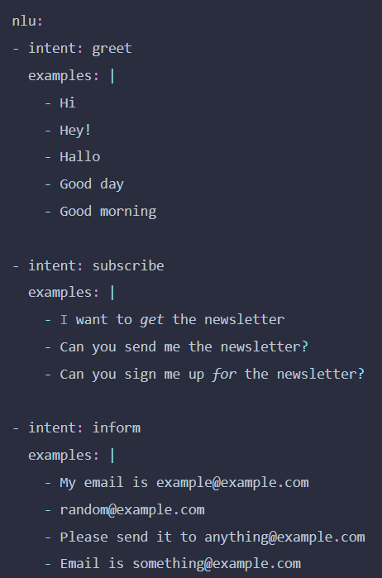
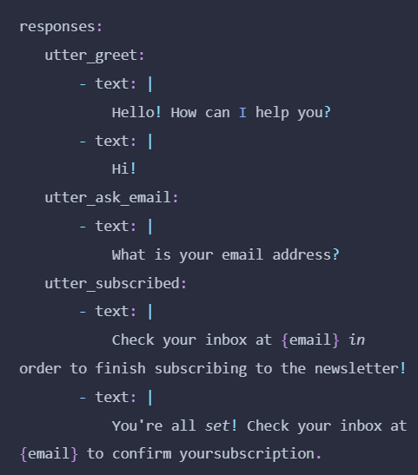
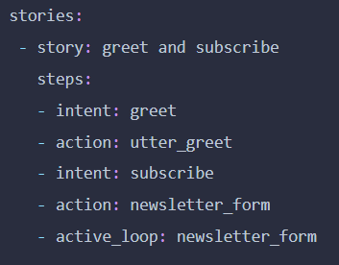
1.NLU data
2.Responses
3.Story
*Reference: https://rasa.com/docs/rasa/

Slide 7
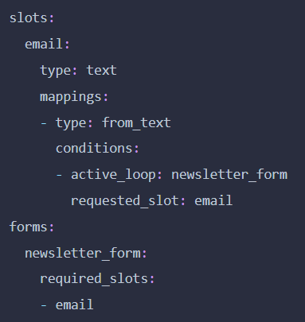
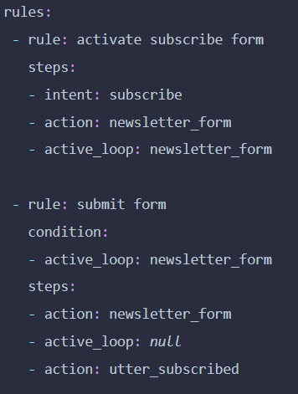
4.Forms
5.Rules
*Reference: https://rasa.com/docs/rasa/

Slide 8
Installations
Installation of anaconda:
Creating virtual environment
Installation of Rasa

Slide 9
Rasa commands
Command | Effect
rasa init | Creates a new project with example training data, actions, and config files.
rasa train | Trains a model using your NLU data and stories, saves trained model in ./models.
rasa interactive | Starts an interactive learning session to create new training data by chatting to your assistant.
rasa shell | Loads your trained model and lets you talk to your assistant on the command line.
rasa run | Starts a server with your trained model.
rasa run actions | Starts an action server using the Rasa SDK.
rasa visualize | Generates a visual representation of your stories.
rasa test | Tests a trained Rasa model on any files starting with test_.
rasa data split nlu | Performs a 80/20 split of your NLU training data.
rasa data convert | Converts training data between different formats.
rasa data migrate | Migrates 2.0 domain to 3.0 format.
rasa data validate | Checks the domain, NLU and conversation data for inconsistencies.
rasa export | Exports conversations from a tracker store to an event broker.
rasa evaluate markers | Extracts markers from an existing tracker store.
rasa -h | Shows all available commands.
*Reference: https://rasa.com/docs/rasa/command-line-interface/

Slide 10
Rasa init
.
├── actions
│ ├── __init__.py
│ └── actions.py
├── config.yml
├── credentials.yml
├── data
│ ├── nlu.yml
│ └── stories.yml
├── domain.yml
├── endpoints.yml
├── models
│ └── <timestamp>.tar.gz
└── tests
└── test_stories.yml
*Reference: https://rasa.com/docs/rasa/command-line-interface/

Slide 11
Tips and tricks to create .bat files to run rasa commands
Open empty notepad and copy these lines
@echo on
call C:\Users\bmsha\Anaconda3\Scripts\activate.bat
(please check you activate.bat in your system and try to paste that path here)
call activate rasapy38
(please activate virtual environment by the name)
call rasa init
(In the above line you enter any rasa commands )
pause
In the last step save the notepad as .bat file
Note:
where you place the .bat file ,it will consider that folder as working directory
Resource file link:
https://github.com/bmshambu/Rasa_chatbot_development

Slide 12
Open AI GPT-3 model
Open ai API key link : https://beta.openai.com/account/api-keys
Open ai playground link https://beta.openai.com/playground
Open ai examples link https://beta.openai.com/examples

Slide 13
Important link
Docker installation link: ocker installation on Windows 11
Rasa Duckling : docker pull rasa/duckling
Running duckling in docker : docker run -p 8000:8000 rasa/duckling
Changing port of rasa server: rasa run -m models --enable-api --cors "*" -p 5006
Changing port of rasa action server: : rasa run actions --port 5056

Slide 14
Thank you

